Slide 2
KATHY TIPTON
CAMT 2020
Spiraling to Success
SpiralEd Practice

Slide 4
Spiraling to Success:
having the questions to “think great thoughts”

Slide 6
Not the paper, but the plan….
Every TEK
Multiple representations
Varied wording
Fewer questions, higher quality

Slide 7
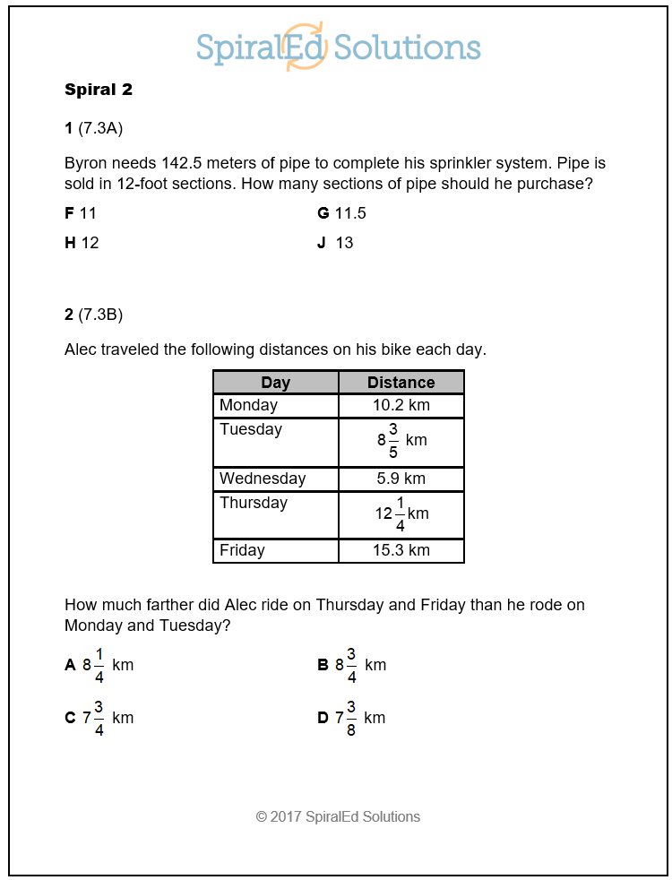
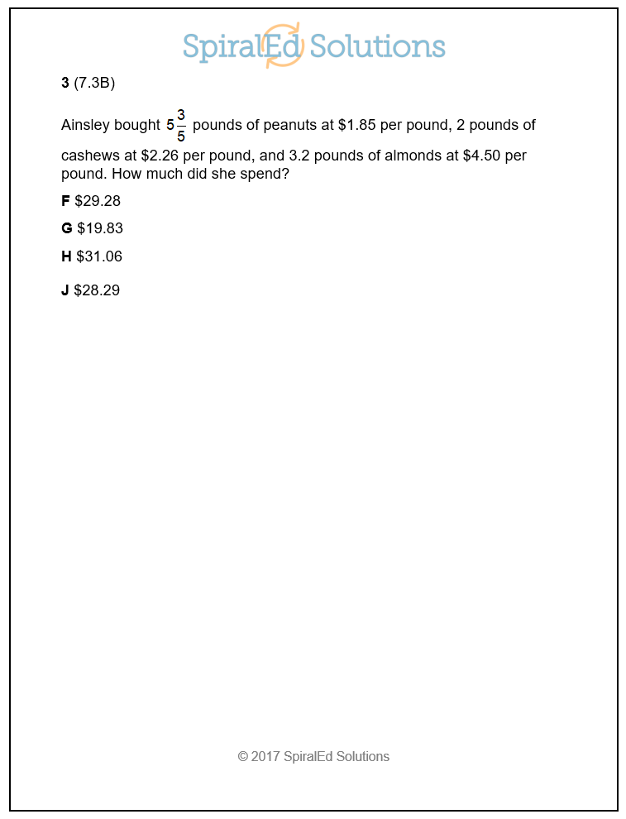
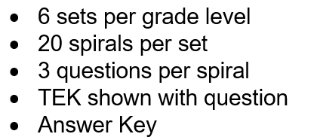

Slide 8
Not the paper, but the process….
Daily practice
Short and sweet
Powerful

Slide 9
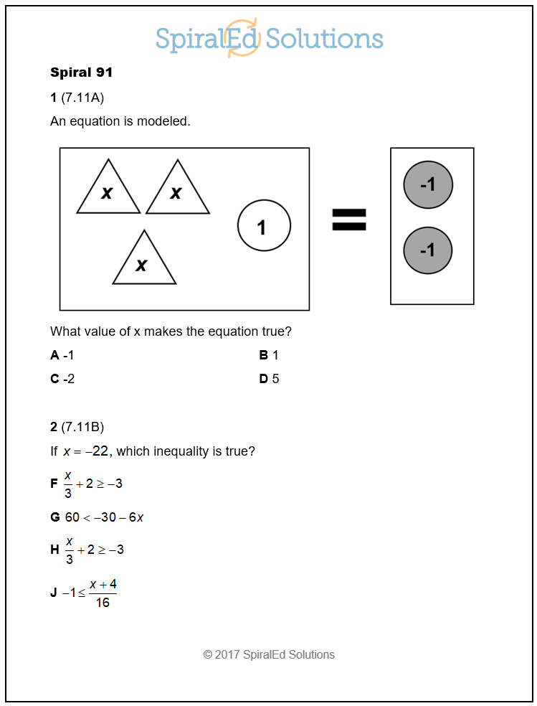
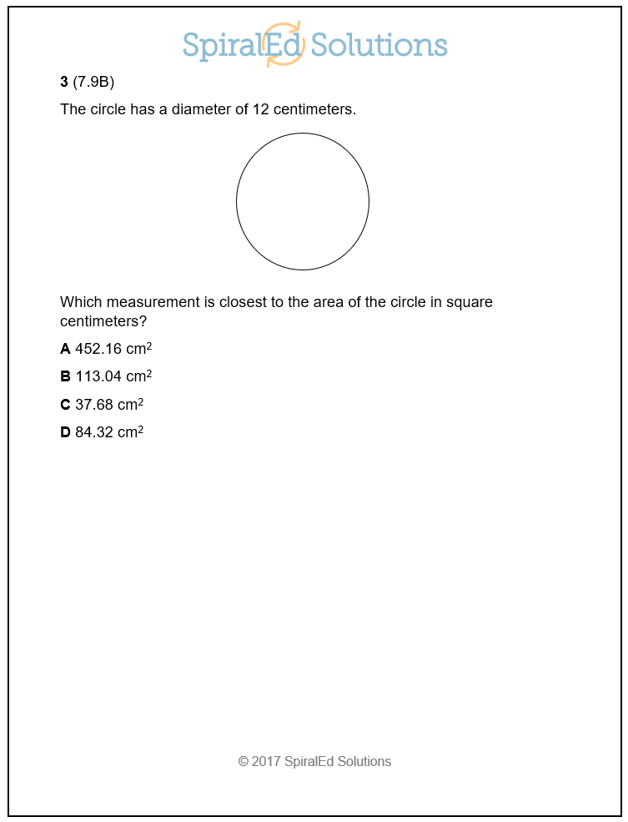

Slide 10
Not the paper, but the partnership….
Differentiation
Access for all
Ownership

Slide 11
Not the paper, but the problem….
Talk with
Talk about
Strategize
Variety

Slide 12
Not the paper, but the presentation….
Printed
Big screen
Small screen and pen
Small screen and paper

Slide 13
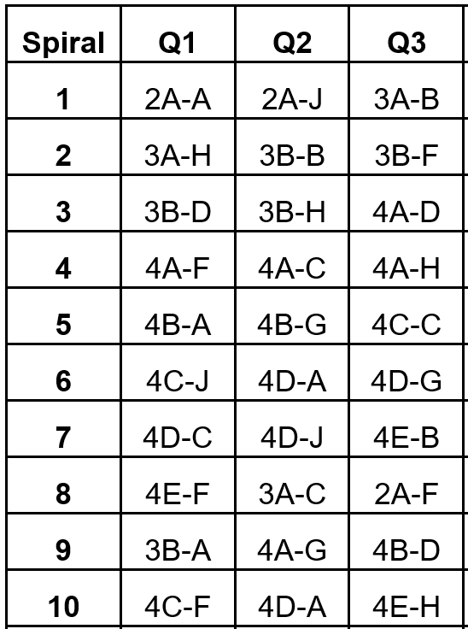
Answer Key

Slide 14
Not the paper, but the progress….
Track success
Share success
Celebrate success

Slide 15
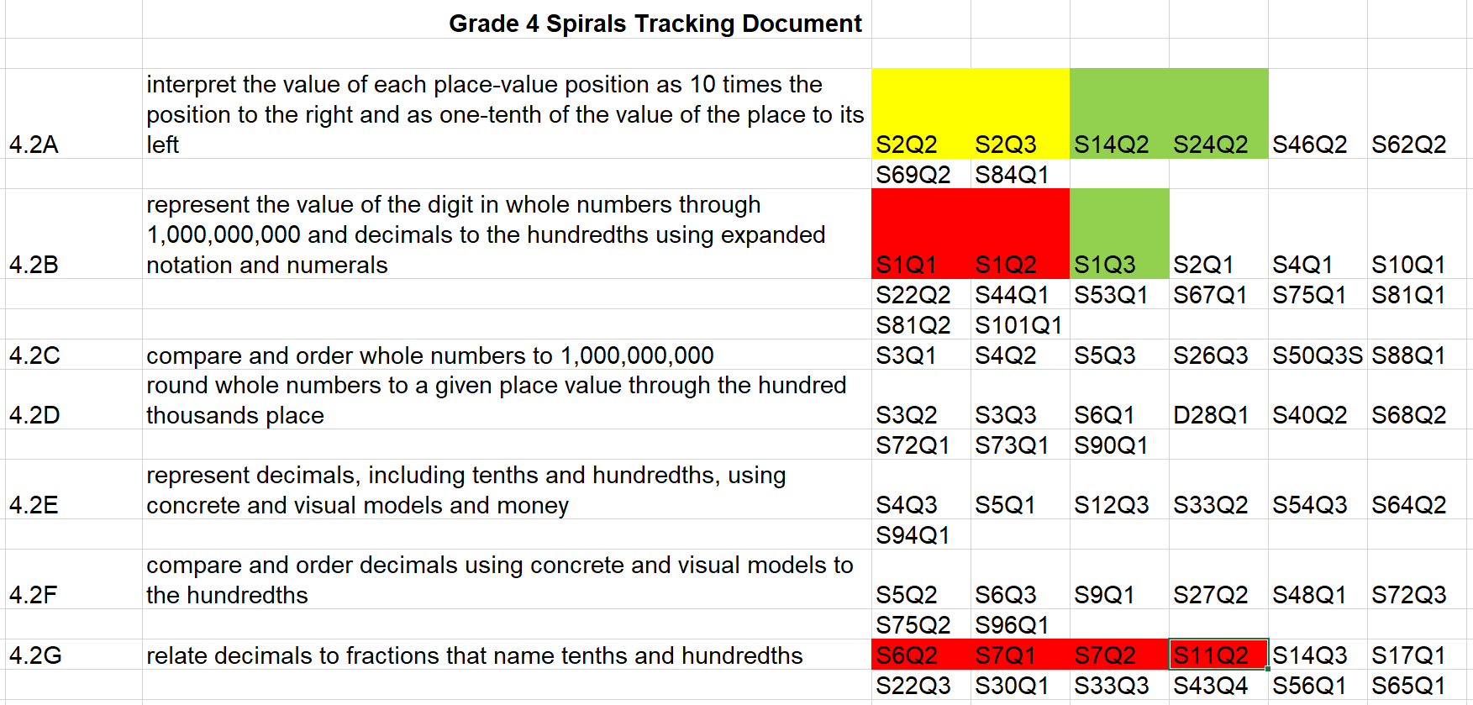
Tracking Document

Slide 16
Lesson Sequence
Warm-up: 5 minutes
Vocabulary Work: 2 – 5 minutes
Spirals: 10 – 12 minutes
Lesson
Wall Work: 5 minutes, embedded

Slide 17
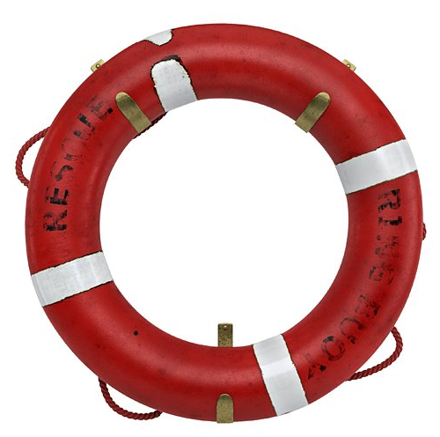
Learning how to learn: for math and for life.
Be an active participant in your own rescue.

