Slide 2
KATHY TIPTON
CAMT 2020
Spiraling to Success
Wall Work

Slide 4
Spiraling to Success:
having the moves to “walk the walk”

Slide 5
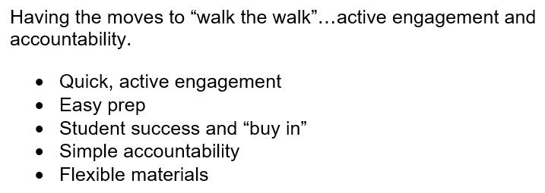

Slide 7
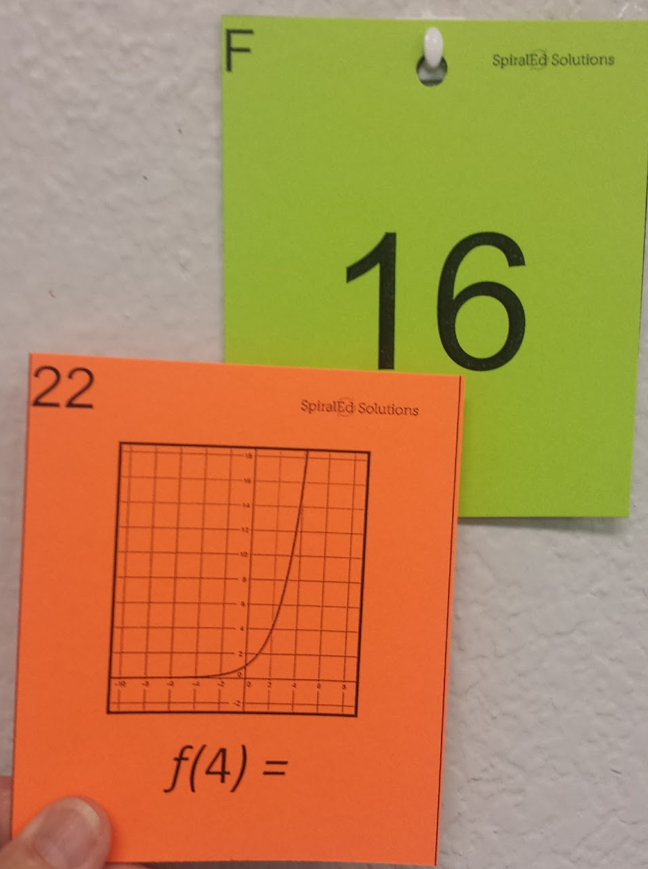

Slide 8
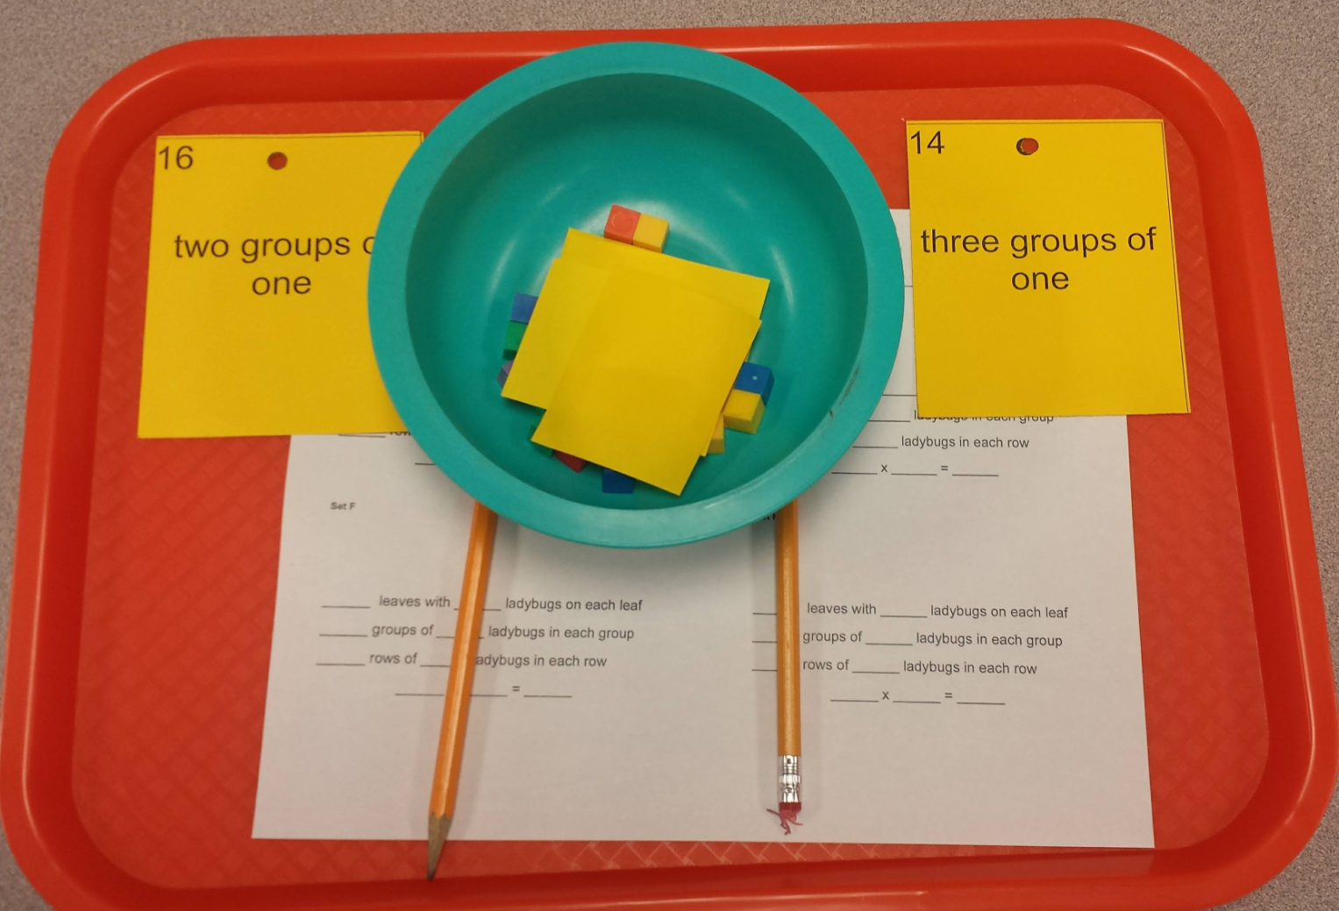
Student management…
Card management…

Slide 9
Accountability….
Formative
Summative

Slide 10
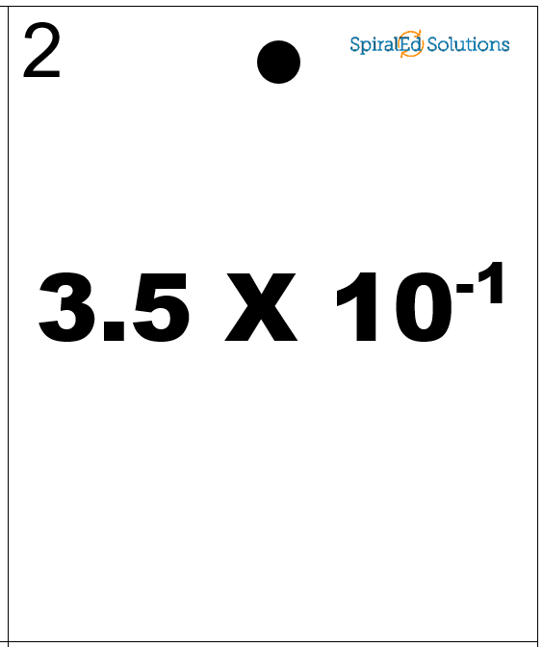
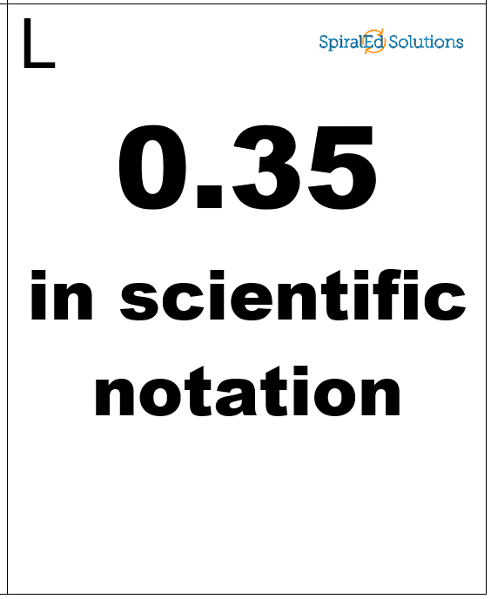
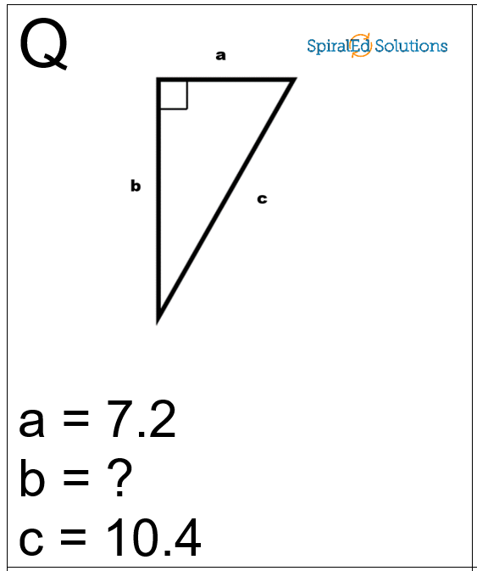
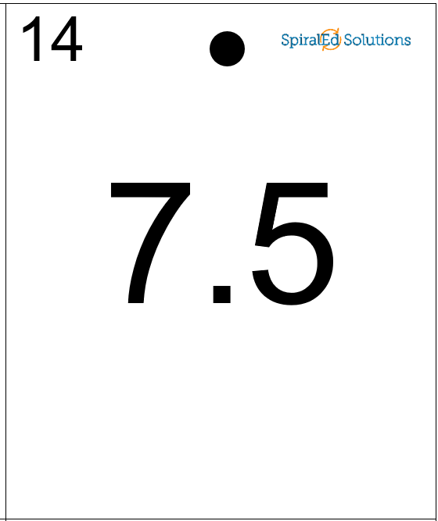
Table Groups
Target specific skills
Differentiate groups
Self-checking
Team races

Slide 11
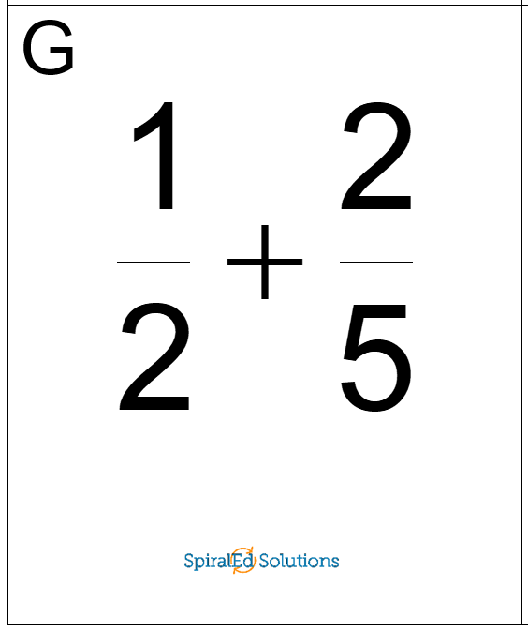
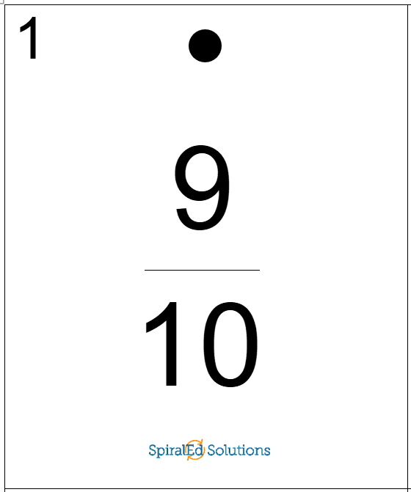
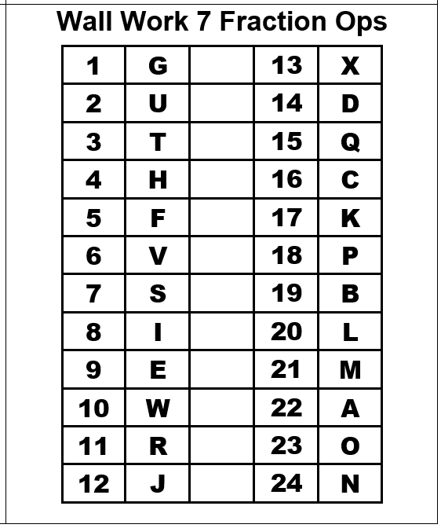
Take Home Sets
Differentiate students
Self-checking
Student buy-in
Student ownership
Parent approved

Slide 12
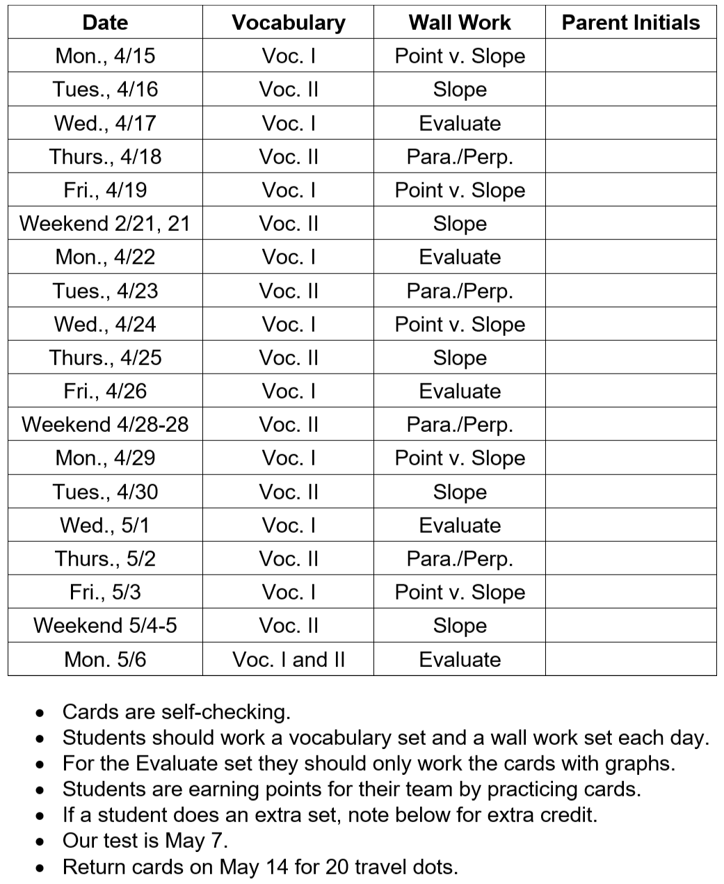
Take Home Sets: Parent Initials

Slide 13
ESL
Resource
Intervention
They’re everywhere!
Dyslexia
PALS
Watchdogs
Sub Folder

Slide 14
30-second Think
What Wall Work topics do I want?
How can I use Wall Work in each class?
What am I comfortable doing with Wall Work?

Slide 15
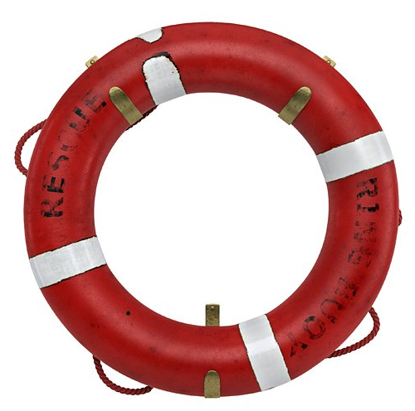
Learning how to learn: for math and for life.
Be an active participant in your own rescue.

